Slide 1
Chapter Health Initiative for Professionals (CHIP)
Chapter Reporting Guide 2021-2022
Nick Tarver
National Professionals Membership Chair
National Society of Black Engineers

Slide 2
CHIP Reports
Number of reports were reduced.
Number of questions reduced.
Focus is on more measurable metrics.
Chapter development discussions conducted more naturally with Regional counterparts based on metrics.
Reporting Cycle
Changed to monthly
Allows Regional Leaders to provide support sooner.
Allows Chapters to better visualize trending performance against their goals.
Key Updates

Slide 3
Focus of CHIP
Primary goal is to ensure Chapters are operating at an optimal standard and receiving support in areas where most needed.
As an added bonus, Chapters that meet or exceed certain performance metrics could receive recognition or rewards.
Chapter Development
Chapter Awards
This Photo by Unknown Author is licensed under CC BY-NC

Slide 4
Chapter Recognition Framework
Certified
Chapter confirms that it is active and existent; able to maintain contact and do basic activities.
Silver
Chapter shares formal plans and is executing some of NSBE's programming.
Gold
Chapter is demonstrating measurable results from its programming and has threshold engagement with PEB/RPEB
Diamond
Chapter is operating at a high level and is demonstrating significant mission-critical results (impact) from their work. Engagement and alignment are high. Chapter is able to develop and share best practices through RPEB and PEB.

Slide 5
CHIP Eligibility
All chapters are encouraged to participate!
……….you won’t get a car though ☺

Slide 6
CHIP Workflow
Chapters Conduct Self-Assessment
Define Chapter Goals
Submit CHIP Reports
Where are we now?
What do we plan to do?
What have we done?
Health Assessment Form
Sample Goals
CHIP Site

Slide 7
SMART Goals (Sample)
Make sure your goals are measurable
Admin | Measurable KPI | Target | Goal % Met | Aug | Sep
Full Executive Board | 10 positions filled | 10 | 40% | 5 | 2
Membership | Measurable KPI | Target | Goal % Met | Aug | Sep
Increase membership | 25% increase | 50 | 32% | 10 | 6
Retain existing members | 60% of members renewed
Conduct a membership recruitment campaign | >= 3 membership drives
Host more membership social activities | 10 social events
Acknowledge more member accomplishments | 10 member spotlights
Programs | Measurable KPI | Target | Goal % Met | Aug | Sep
Partner with more NSBE Jr chapters | 3 NSBE Jr Chapters sponsored | 3 | 67% | 1 | 1
Partner with more Collegiate Chapters | 3 College Chapters sponsored
Host or support more collegiate events | 5 CI events hosted
Host or support more PCI events | 5 PCI events hosted
Build or strengthen partnerships with external organizations (e.g. IEEE, BMBA, SHPE, etc.) | 5 external relationships established
Increase # of Professional Development Workshops | 10 workshops
Increase # of national mentorship volunteers | 20 Mentors signed up
Finance | Measurable KPI | Target | Goal % Met | Aug | Sep
Establish more corporate partnerships | 5 corporate sponsors | 5 | 80% | 2 | 2
Increase Scholarship Fund | >= $10,000 | $ 10,000.00 | 26% | $ 2,569.00
Launch Fundraising campaign | raise >= $50,000 | $ 50,000.00 | 16% | $ 7,858.00
Communications | Measurable KPI | Target | Goal % Met | Aug | Sep
Increase IG followers | >=2000 followers | 2000 | 56% | 1100 | 10
Increase Twitter followers | >=2000 followers
Increase FaceBook followers | >=2000 followers

Slide 8
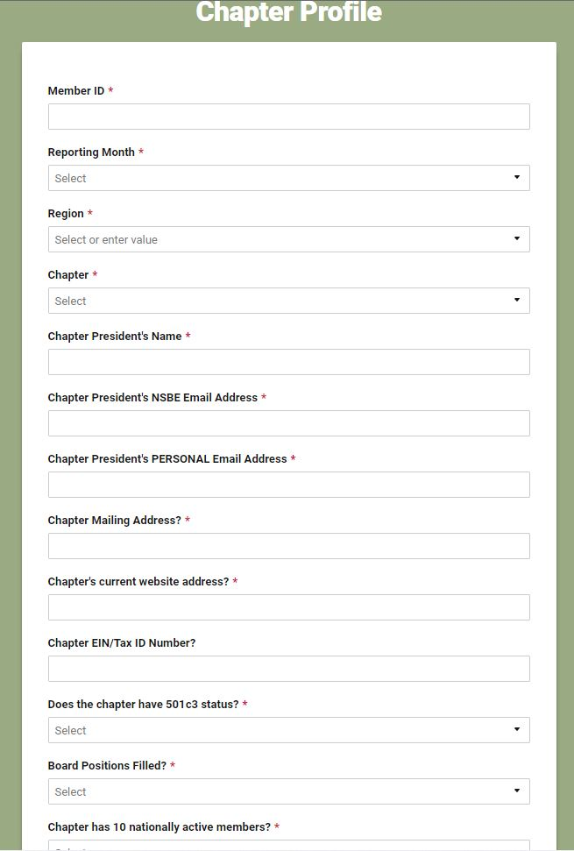
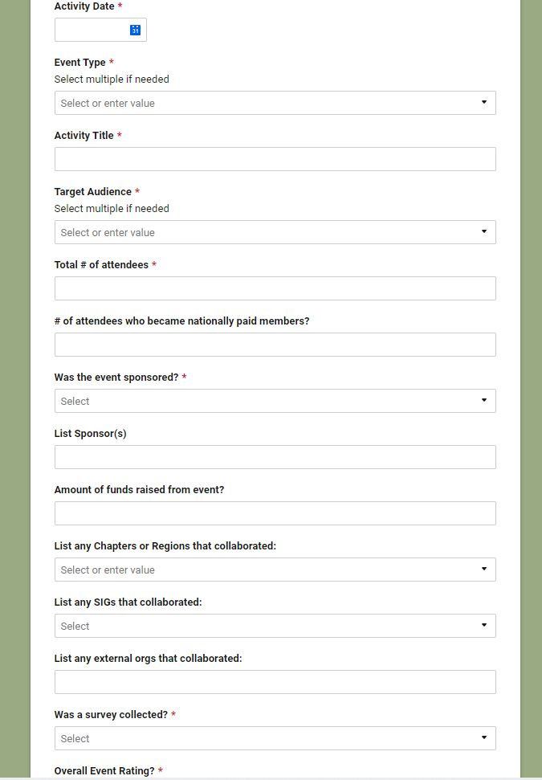
CHIP Reports
Chapter Reports (Three types)
Chapter Profile Form
Purposes:
To intake chapters into the CHIP program
To collect basic vitals from chapters
To track charter status
Submission Frequency:
Report until all requirements have been met or if there’s an update.
Chapter Activity Report Form
Purpose:
To capture information/data on specific events being executed by chapters
Submission Frequency:
One submission for each chapter event. (Submitted after event completion).
Chapter Monthly Report Form
Purpose:
To capture information/data on the health and performance of the chapter.
Submission Frequency:
Once per month, due at end of the month.

Slide 9
CHIP Reports (cont’d)
Links to all the CHIP reports are below:
Chapter Profile
Membership Report
Financial Report
TORCH Report
Activity Report
PCI Report
Marketing & Communications
Chapter Goals & Progress
College Initiative
Member Recognition

Slide 10
Chapter Contacts
Chapter Leaders are required to complete the global contact form.
This form captures the leaders' role, office term, membership status, and contact information.
Chapters are also required to complete the Chapter Profile form
Chapter contact information collected aids members with contacting chapters.
Provides the finance zone with vitals that assist with issuing chapters funds donated from partners or sponsors.
Chapter Leader Global Contacts
Chapter Profile

Slide 11
Activity Surveys
Chapters are encouraged to provide standard surveys at the end of each activity.
Surveys provide important feedback on the usefulness and quality of the activity.

Slide 12
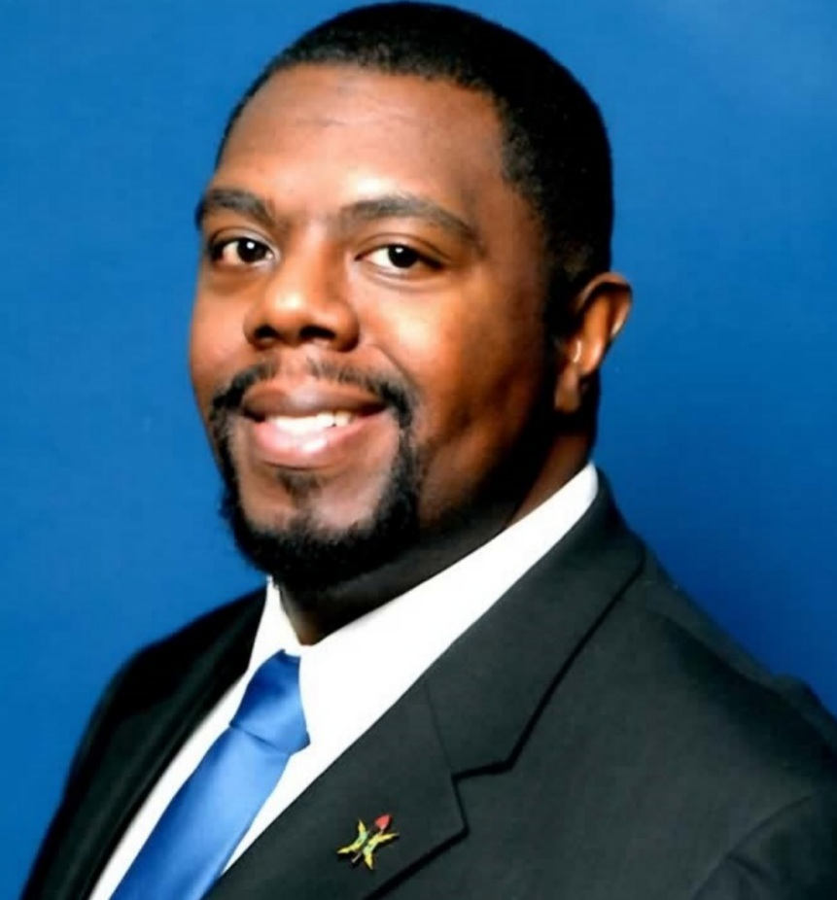
Please contact me with any questions.
Nick Tarver PebMembership@nsbe.org

